Slide 1
Comp2151 Lecture4 Scrum Processes
Reference: https://www.scrumstudy.com/sbokguide

Slide 2
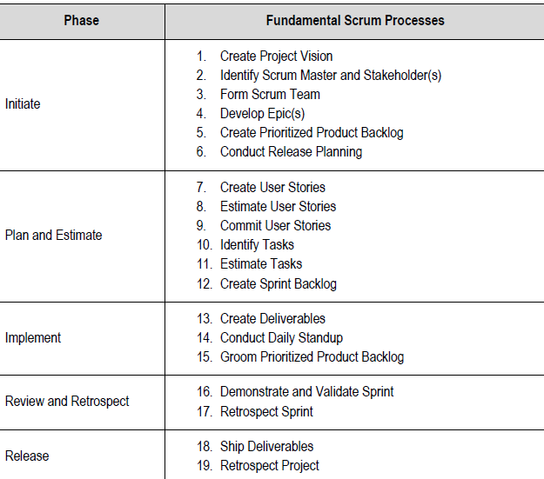
Scrum Process Framework
SBOK™ Guide

Slide 3
Phase 1: INITIATE
This Phase consists of the following six processes involved in the initiation of a project.
1. Create Project Vision
2. Identify Scrum Master and Stakeholder(s)
3. Form Scrum Team
4. Develop Epic(s)
5. Create Prioritized Product Backlog
6. Conduct Release Planning

Slide 4
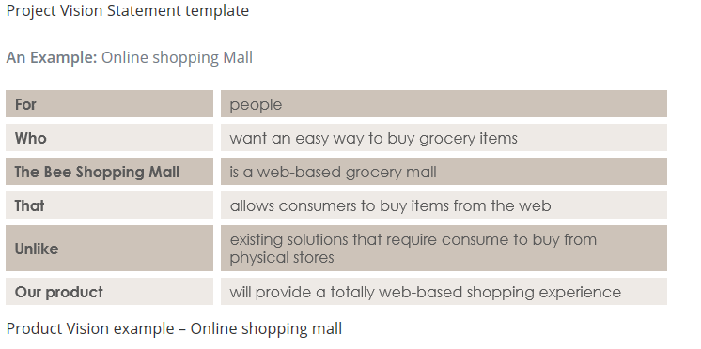
1.1 Create Project Vision (1)
Project Vision Statement is created by reviewing the Business Case(written by business analysts).
This vision statement provides inspiration and focus for the entire project. The Product Owner is identified.
Template and Example from Visual Paradigm

Slide 5
1.2 Identify Scrum Master and Stakeholders(2)
Selecting appropriate Scrum Master(s) and identifying relevant Stakeholder(s) is crucial to the success of A Scrum project.
Input from the H-R department should be sought during the selection process.
Teams’ knowledge gaps should be assessed by the Product Owner and team training should be arranged.

Slide 6
1.3 Form Scrum Team (3)
Scrum team members should be independent, self-motivated, customer-focused, responsible, and collaborative.
Expert advice from the H-R department should be sought for team selection.
Resource costs should be assessed analysed and budgetary approvals should be ensured during this process.
Training needs and costs should also be assessed and approved.

Slide 7
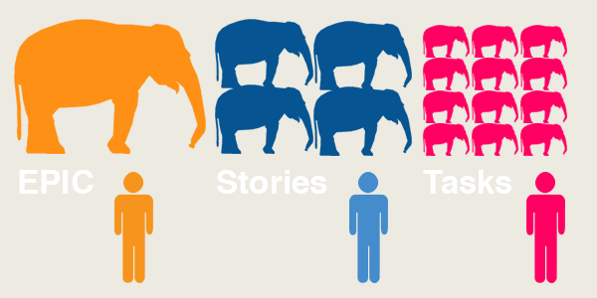
1.4 Develop Epics (4)
Epics are large and unrefined stories and should be written in the initial phases of the project.
These epics are then broken down in user stories. Example “Create a Website for the Company”
https://pm.stackexchange.com/questions/16739/what-is-the-weighting-difference-between-epic-story-task

Slide 8
1.5 Create Prioritized Product Backlog (5)
There are various User stories prioritization techniques:
MoSCoW: “Must have,” “Should have,” “Could have,” and “Won’t have”.
Paired Comparison: Each User Story is compared with another story and decision is made regarding which of the two is more important.
100-Point Method: Customers assign points 1-100 to each story.

Slide 9
1.6 Conduct Release Planning (6)
The Release Planning Schedule states which deliverables are to be released to the customers, along with planned intervals, and dates for releases.
There may not be a release scheduled at the end of every Sprint
iteration.
At times, a release may be planned after a group of Sprint iterations are completed.

Slide 10
Phase2: PLAN AND ESTIMATE
This Phase consists of the following processes:
7. Create User Stories
8. Estimate User Stories
9. Commit User Stories
10. Identify Tasks
11. Estimate Tasks
12. Create Sprint Backlog

Slide 11
2.1 Create User Stories (7)
User stories are the smallest units of user functionality in agile which can be delivered in one agile sprint.
A user story must deliver particular value to the user and must be describable in simple language that outlines the desired outcome.
User Stories and their related User Story Acceptance Criteria are created.
User Stories are usually written by the Product Owner and are designed to ensure that the customer’s requirements are clearly depicted and can be fully understood by all stakeholders.

Slide 12
2.2 Estimate User Stories (8)
A comparative analysis to estimate the relative size of product backlog items (or stories).
Techniques (Covered in Lecture-3)
1.Planning Poker
2. Bucket System
3. Big Uncertain Small (TFB/NFC/1)
4. Ordering protocol
5. Divide until Maximum Size or Less
6. T-Shirt Sizes

Slide 13
2.3 Commit User Stories (9)
The Scrum Team commits to a subset of Estimated User Stories that they believe they can complete in the next Sprint based upon velocity. The Committed User Stories should always be selected per the priorities
defined by the Product Owner.

Slide 14
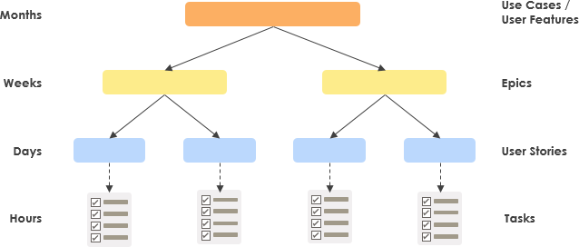
2.4 Identify Tasks (10)
Tasks are technical implementation of a story into a software feature.
Mapping stories to tasks
https://www.visual-paradigm.com/scrum/theme-epic-user-story-task/

Slide 15
2.5 Estimate Tasks (11)
Estimating of the duration and effort required to accomplish each task in the Task List. The result of this process is an Effort Estimated Task List.
Task dependencies (predecessors) are also established.
Estimation is done based on experience or consulting the plan for a similar project.
Some mathematical models have also been developed to estimate task durations.

Slide 16
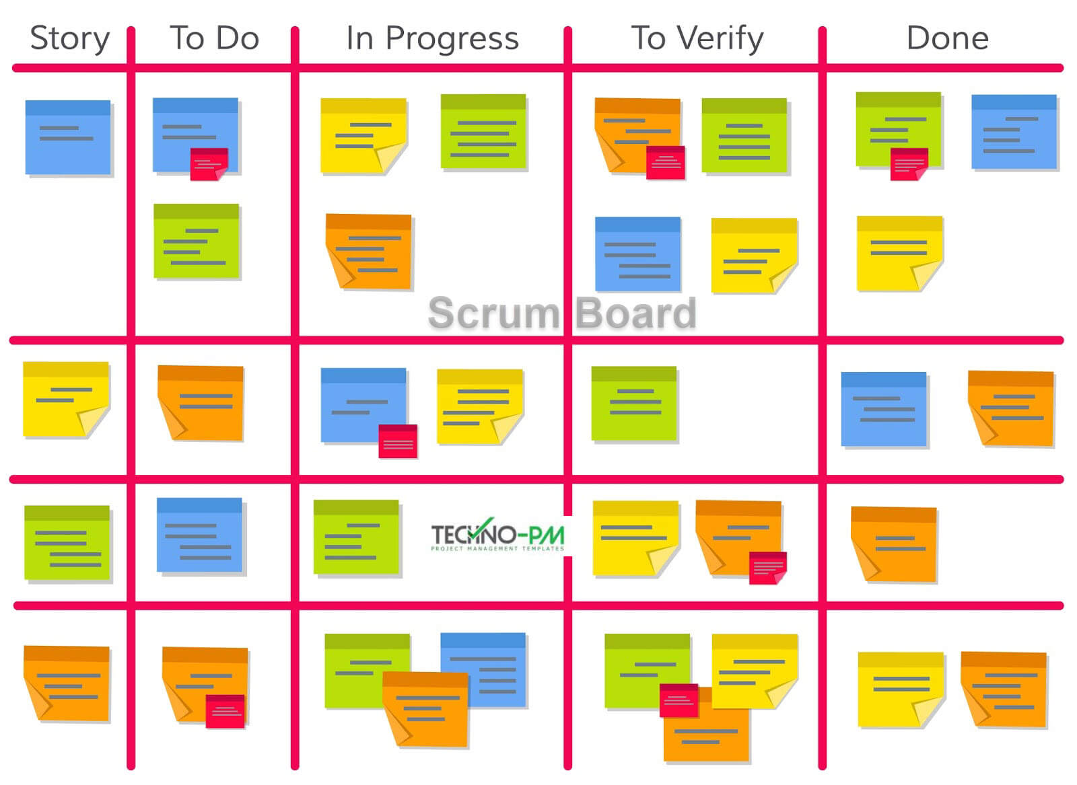
2.6 Create Sprint Backlog (12)
The list of the tasks to be executed by the Scrum Team in the upcoming Sprint is called the Sprint Backlog.
It is common practice that the Sprint Backlog is represented on a Scrumboard.
Risks would also be included as tasks in the Sprint Backlog along with any mitigating activities.

Slide 17
Phase3: IMPLEMENT
This Phase consists of the following processes:
13. Create Deliverables
14. Conduct Daily Standup
15. Groom Prioritized Product Backlog

Slide 18
3.1 Create Deliverables (13)
Inputs: Sprint backlog, Scrumboard, Impediment Log(hurdles faced by the team are logged)
Tools:
Refactoring: Make the code simpler, concise, flexible
Design Patterns: introduce software design patterns as it improves productivity
Outputs:
Sprint deliverables: successful implementation and testing of the Features and functionality defined in the User Stories included in the Sprint.
Updated Scrum board and impediment log
Identify and mitigate risks

Slide 19
3.2 Conduct Daily Standup (14)
Time boxed event (15 minutes)
Team members provide status update to fellow team members about the achievements and experience from the previous work day.
Three Daily Questions
What have I done since the last meeting?
What do I plan to do before the next meeting?
What impediments or obstacles (if any) am I currently facing?
The war room: all team members should be collocated, index cards, sticky notes, and other low-tech, high-touch tools are made available in the room to facilitate workflow, collaboration, and problem solving.
Outputs: Updated Sprint Burndown Charts and impediment logs, change requests, identified and mitigated risks

Slide 20
3.3 Groom Prioritized Product Backlog(15)
Rejected Deliverables: The deliverables that do not meet the Acceptance Criteria remain in the Prioritized Product Backlog but don't get marked as done so that they can be reprioritized in the Groom Prioritized Product Backlog process and be considered for development in the next Sprint.
Prioritized Product Backlog Review Meetings: The Product Owner conducts multiple and separate meetings with relevant Stakeholder(s), the Scrum Master, and the Scrum Team to ensure that he or she has enough information to make updates to the Prioritized Product Backlog during the Groom Prioritized Product Backlog process.
The intent of this meeting is to ensure that User Stories and Acceptance Criteria are understood and are written properly by the Product Owner so that they reflect the actual stakeholder (customer) requirements and priorities.

Slide 21
Phase4: REVIEW AND RETROSPECT
reviewing the deliverables and the work that has been done and determining ways to improve the practices and methods used to do project work
This Phase consists of the following processes:
16. Demonstrate and Validate Sprint
17. Retrospect Sprint Release

Slide 22
4.1 Demonstrate and Validate Sprint(16)
The Scrum Team demonstrates the Sprint deliverables to the Product Owner and relevant stakeholders in a Sprint Review Meeting. The purpose of this meeting is to secure approval and acceptance of the product or service by the Product Owner.
Outputs
Deliverables which meet the User Story Acceptance Criteria are accepted by the Product Owner.

Slide 23
4.2 Retrospect Sprint (17)
Scrum Master and Scrum Team meet to discuss the lessons learned throughout the Sprint.
This information is documented as lessons learned which can be applied to future Sprints.
Outputs
Agreed Actionable Improvements
Updated Scrum Guidance Body Recommendations

Slide 24
Phase5: RELEASE
The Release phase emphasizes delivering the Accepted Deliverables to the customer and identifying, documenting, and internalizing the lessons learned during the project.
This Phase consists of the following processes:
18. Ship Deliverables
19. Retrospect Project

Slide 25
5.1 Ship Deliverables(18)
Accepted Deliverables are delivered or transitioned to the relevant stakeholders. A formal Working Deliverables Agreement documents the successful completion of the Sprint.
The Product Releases
Release Content —This consists of essential information about the deliverables that can assist the customer support team.
Release Notes —Release Notes should include external or market facing shipping criteria for the product to be delivered.

Slide 26
5.2 Retrospect Project (19)
This process completes the project.
Organizational stakeholders and Scrum Core Team members assemble to retrospect the project and identify, document, and internalize the lessons learned.
Often, these lessons lead to the documentation of Agreed Actionable Improvements, to be implemented in future projects.

